Slide 1
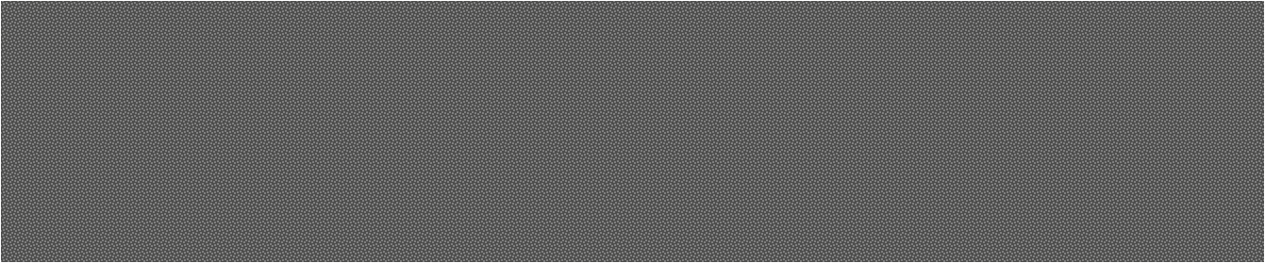

VLSI Design Flow

Slide 2
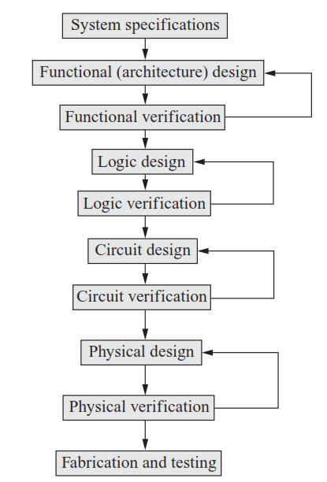
VLSI Design Flow

Slide 3
Y Chart
The Y-chart is a model, which captures the considerations in designing semiconductor devices.
The Y-chart in VLSI has been developed by Gajski and Kuhn in the year 1983.
The Y-chart consists of three major domains, namely:
behavioral domain,
structural domain,
geometrical layout domain.

Slide 4
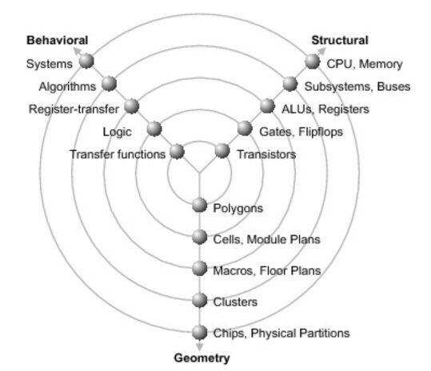
Y Chart

Slide 5
Y Chart
Physical/geometry domain:-
At the physical domain it is first necessary to subdivide a large system into small sized pieces which is referred as physical partition.
After that the small blocks are arranged together in the form of clusters.
floor plan is necessary to find out the approximate location of each module or block in the chip.
In module layout and cell layout , each unit of block to be placed on chip and the connections between the cells and the block is defined.

Slide 6
Y Chart
Behavioural domain:-
The behaviour of the entity can be modelled using procedural code which can represent the circuit at a higher level of abstraction.
The first hierarchy is system where the behavior of the architecture is defined.
Then a set of algorithm needs to be defined for processing the different parameters and a set of flowchart.
The third step is RTL (register transfer level) where the coding needs to be done and then the logic level where we are concerned with 0 and 1 level, after which the transfer function is defined.

Slide 7
Y Chart
Structural domain:-
A particular block is connected across with set of signals or netlist and here in this case we are more interested in the structure.
Generally the people in this field are more interested to know how a system works.
So all CPU design, verification related works come in this field as this domain is more inclined towards processors and memories.

Slide 8
Structured Design
Regularity
Divide the hierarchy in to similar building blocks whenever possible.
Aids the management of design complexity by designing the minimum number of different blocks
Some programmability could be added to achieve regularity.
Modularity
Well defined behavioural, structural and physical interface.
Helps: divide tasks into well defined modules, design integration, aids in team design.
Locality
Involves keeping information where it is used, physically and temporally

Slide 9
Design Styles
Depending on the application, cost of production, performance, and the volume of production, there are different VLSI design styles that are followed to implement a chip.
The commonly used design styles are as follows:
Field programmable gate array (FPGA) design
Gate array design
Standard cell-based design
Full-custom design
Semi-custom design
Programmable logic device (PLD)

Slide 10
FPGA
The full form of FPGA is “Field Programmable Gate Array”.
FPGA is a fully fabricated IC chip in which the interconnections can be programmed to implement different functions.
An FPGA chip has thousands of logic gates which are to be connected to implement any logic function.
It has the following three main components:
I/O buffers
Array of configurable logic blocks (CLBs)
Programmable interconnects

Slide 11
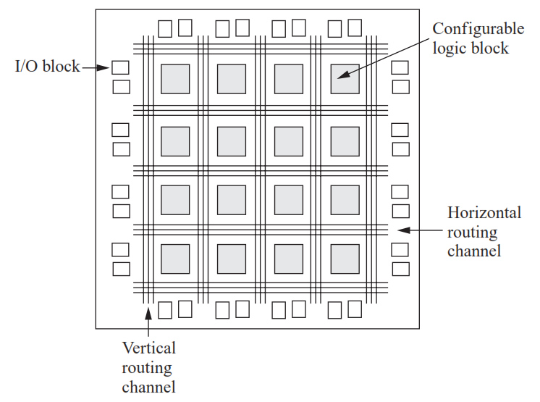
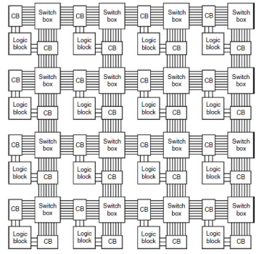
FPGA Architecture
Notes:
A lookup table is a data structure in the form of an array, often used to replace a runtime computation with a simpler array indexing operation. The savings in terms of processing time can be significant, since retrieving a value from memory is often faster than undergoing an 'expensive' computation
The flip flop allows for control of the output in correlation with clock management and is also used for feedback purposes
Each input is accessible from one side of the logic block, while the output pin can connect to routing wires in both the channel to the right and the channel below the logic block.
Each logic block output pin can connect to any of the wiring segments in the channels adjacent to it.
Similarly, an I/O pad can connect to any one of the wiring segments in the channel adjacent to it. For example, an I/O pad at the top of the chip can connect to any of the W wires (where W is the channel width) in the horizontal channel immediately below it.
Generally, the FPGA routing is unsegmented. That is, each wiring segment spans only one logic block before it terminates in a switch box. By turning on some of the programmable switches within a switch box, longer paths can be constructed. For higher speed interconnect, some FPGA architectures use longer routing lines that span multiple logic blocks.
Whenever a vertical and a horizontal channel intersect, there is a switch box. In this architecture, when a wire enters a switch box, there are three programmable switches that allow it to connect to three other wires in adjacent channel segments. The pattern, or topology, of switches used in this architecture is the planar or domain-based switch box topology. In this switch box topology, a wire in track number one connects only to wires in track number one in adjacent channel segments, wires in track number 2 connect only to other wires in track number 2 and so on

Slide 12
FPGA
I/O buffers, which are designed and numbered according to function.
CLB performs the logic operation given to the module.
The inter connection between CLB and I/O blocks are made with the help of horizontal routing channels, vertical routing channels and PSM (Programmable Multiplexers).
The functionality of CLB’s and PSM are designed by VHDL or any other hardware descriptive language.
After programming, CLB and PSM are placed on chip and connected with each other with routing channels

Slide 13
FPGA
The benefits of using the FPGA-based design are that the design cycle time is very short and very much suitable for low volume prototype development with low cost.
A concept can be quickly implemented in the hardware and checked if it is worth implementing in a large volume.
But FPGA-based design is not optimized for performance.
The typical design time is few hours to a couple of days for an FPGA-based design.

Slide 14
Gate Array Design
In a gate array (GA) structure, the transistors are fabricated on the silicon wafer.
But the interconnections are not fabricated. The metal mask layers are customized to define the interconnections between the transistors for a targeted functionality.
It can also be used for the prototype development in short time, ranked after the FPGA.
Depending on the array structure, the GA are of the following three types:
Channeled
Channel-less
Structured

Slide 15
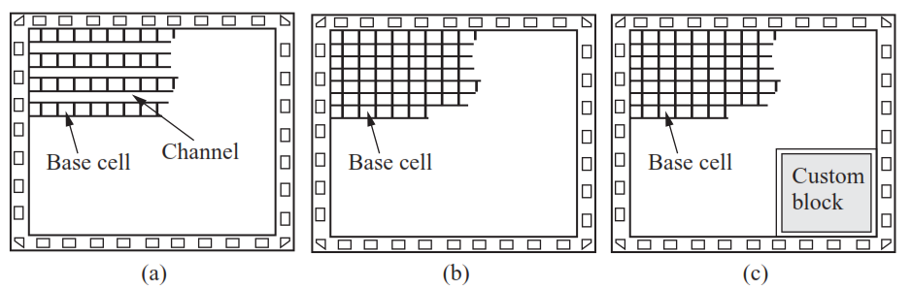
Gate Array Design
Gate array (GA) architecture: (a) channeled (b) channel-less (c) structured

Slide 16
Gate Array Design
In the channeled gate array architecture, there are rows of transistors called arrays and channels are provided between the rows of transistors for their interconnections.
In the channel-less gate array there are no channels between the rows. As there are no channels in the channel-less architecture, the interconnections are made by drawing metal lines through the unused transistors.
In case of the structured GA architecture, either channeled or channel-less structure can be used, but the only difference is that it includes custom blocks.

Slide 17
Standard Cell-based Design
The standard cell-based integrated circuit refers to a class of integrated circuits which uses the pre-designed, pre-tested, and pre-characterized standard cells.
The standard cells include
basic logic gates (AND, OR, NAND, NOR, XOR, XNOR, NOT, etc.),
some mega cells (such as multiplexer, full-adder, decoder, etc.),
sequential elements (such as D flip-flop with direct set/reset/clear inputs, registers, etc.),
input–output buffers (I/O cells), and some special cells.
All these standard cells are designed, tested, and characterized and put in a database which is known as a standard cell library.
This design style also includes some fixed blocks.

Slide 18
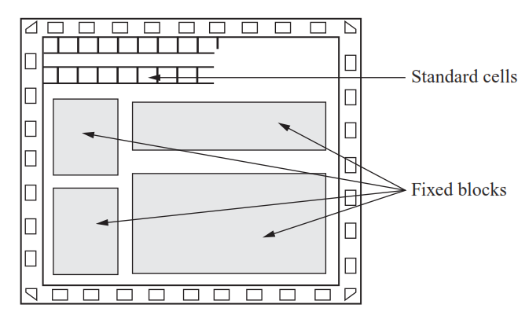
Standard Cell-based Design

Slide 19
Full-custom Design
In the full-custom design, the designers do not use the pre-designed standard cell library.
Instead, they design the entire chip from the scratch.
As each and every part is designed in this approach, the chips are highly optimized for area, power, and delay.
A full-custom design is always superior to any other design style. Full-custom design style is used for high performance and high volume products.

Slide 20
Programmable Logic Device (PLD)
Programmable logic devices (PLDs) are standard products, which can be programmed to obtain the desired functionality required for a specific application.
The programming can be done either by the end user or by the manufacturer.
The PLDs which are programmed by the manufacturer are known as mask-programmable logic devices (MPLDs).
The PLDs, which are programmed by the end user are called field-programmable logic devices (FPLDs).

Slide 21
Programmable Logic Device (PLD)
The architecture of PLDs is very regular and fixed. It cannot be changed by the end user.
The PLDs have wide range of applications and have low risk and cost in manufacturing in large volume.
The PLDs are classified into three categories based on the architecture and programmability:
Read only memory (ROM)
Programmable array logic (PAL)
Programmable logic array (PLA)

Slide 22
Hardware Description Language
A hardware description language (HDL) is a specialized computer language used to describe the structure and behavior of electronic circuits, and most commonly, digital logic circuits.
The structure, operation and design of the circuits are programmable using HDL.
HDL includes a textual description consisting of operators, expressions, statements, inputs and outputs.
Instead of generating a computer executable file, the HDL compilers provide a gate map.

Slide 23
Hardware Description Language
The gate map obtained is then downloaded to the programming device to check the operations of the desired circuit.
The language helps to describe any digital circuit in the form of structural, behavioral and gate level.
The three common HDLs are
Verilog
VHDL
SystemC
SystemC is the newest. The HDLs will allow fast design and better verification. In most of the industries, Verilog and VHDL are common.

